Slide 1
Template for logicReasoning 10 minutes
Liang Kuang
2017-05-05

Slide 2



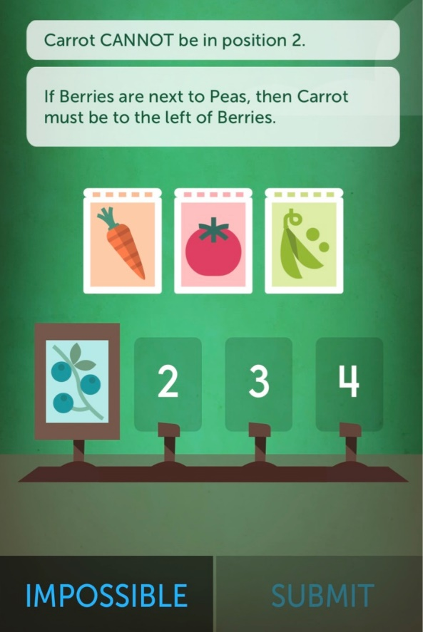
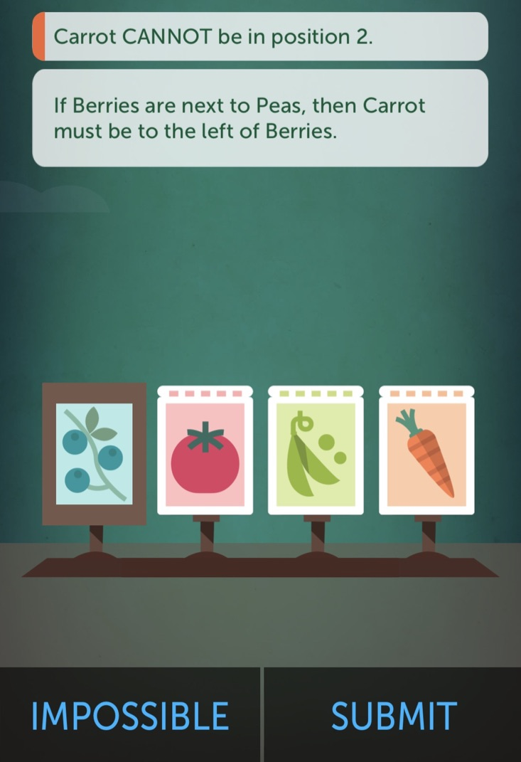
Demo Question
Drag and Drop
Q
Answer
One solution

Slide 3

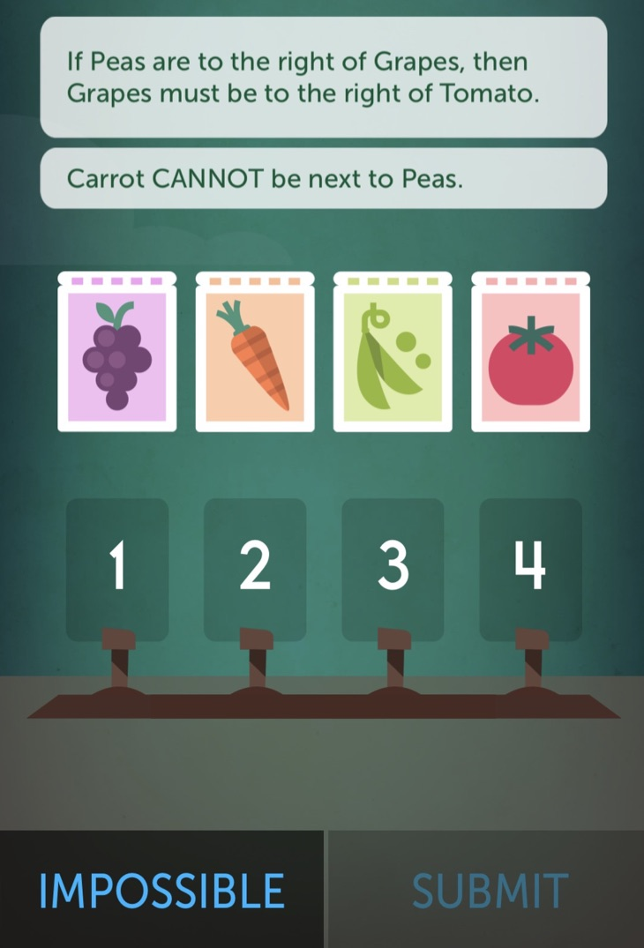
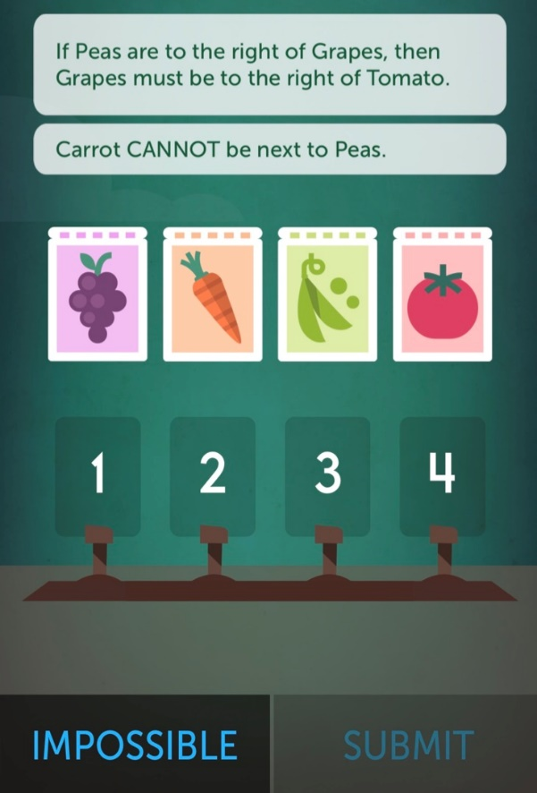
Question 1
Drag and Drop
Q
Answer

Slide 4
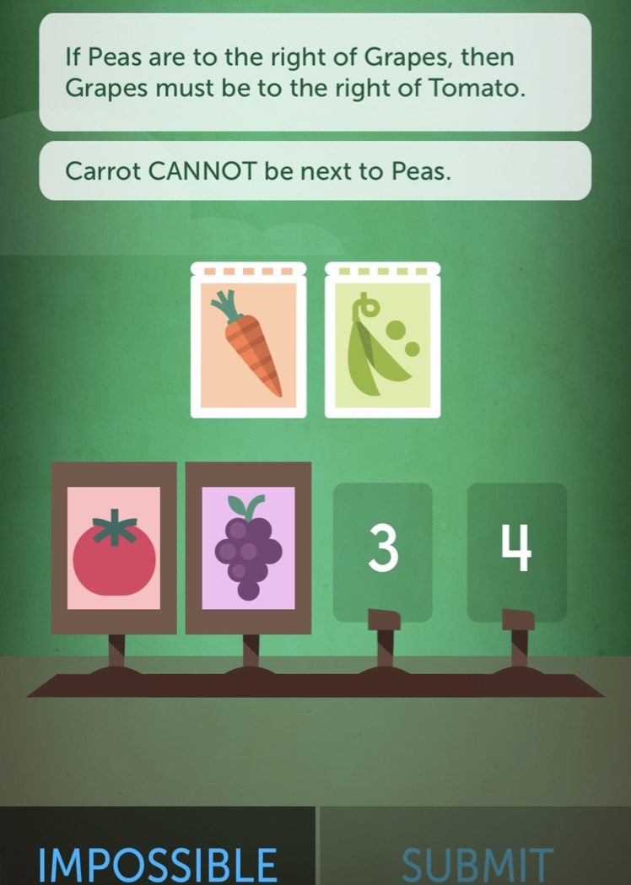
Question 3
Drag and Drop
Q
Answer

Slide 5

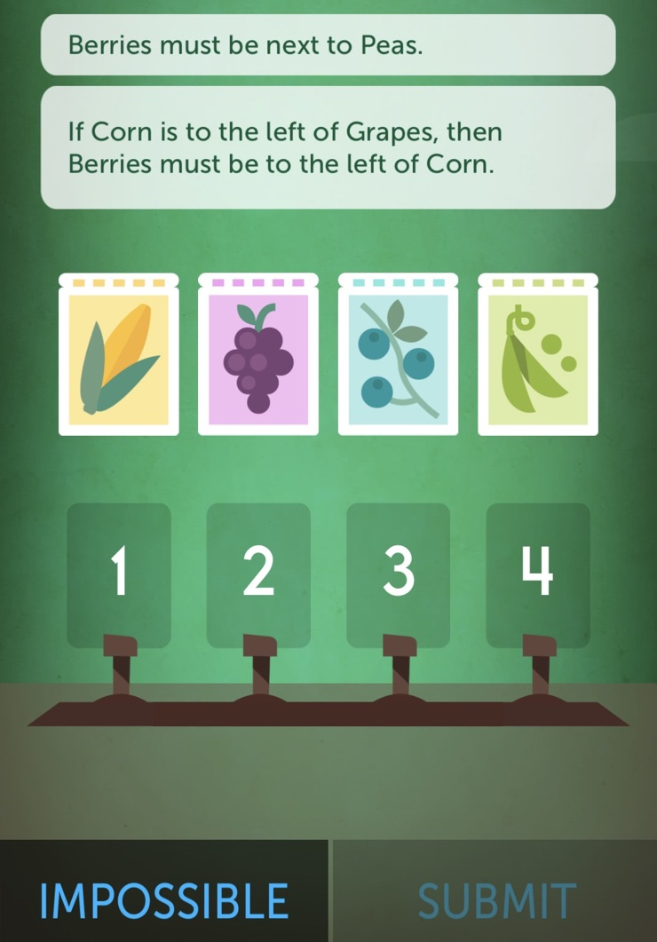
Question 4
Drag and Drop
Q
Answer

Slide 6





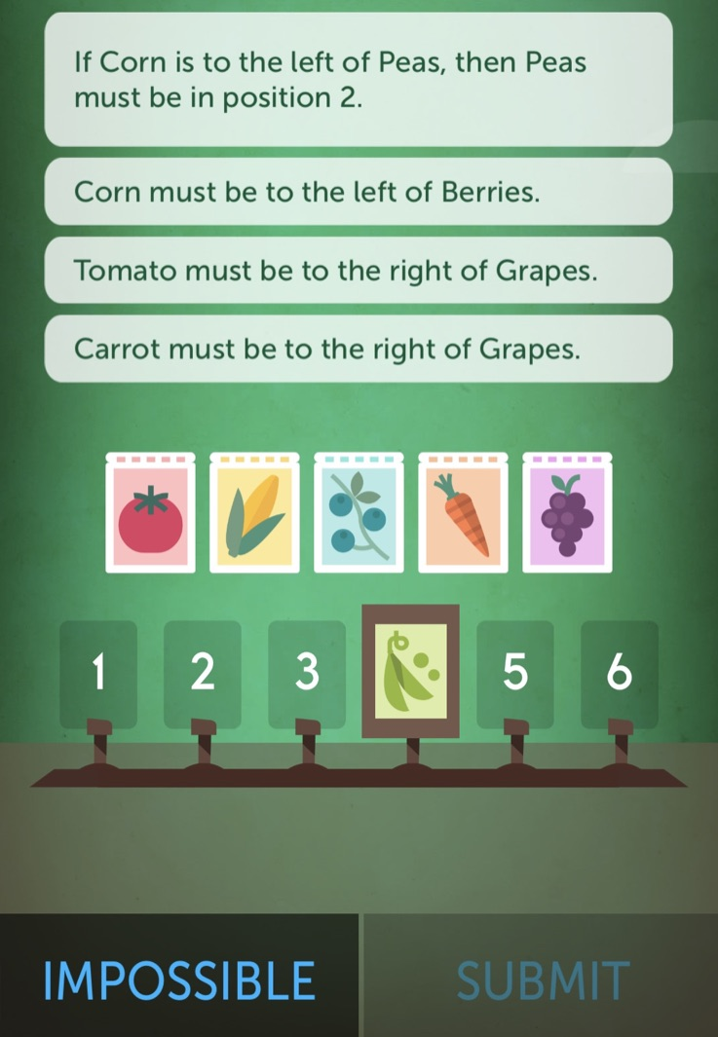
Question 5
Drag and Drop
Q
Answer

Slide 7
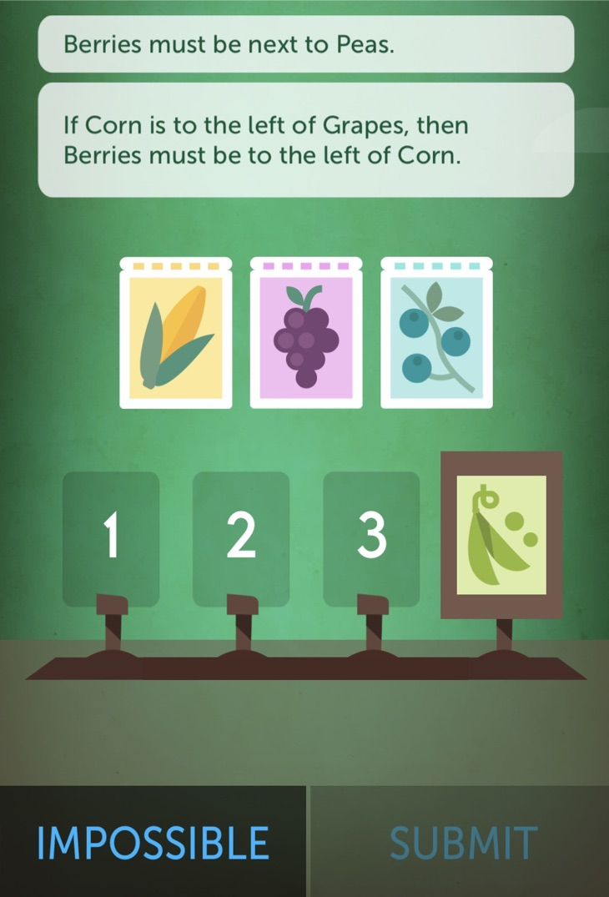
Question 6
Drag and Drop
Q
Answer

Slide 8


